Slide 1
Hortonworks Assessment
Pavan Challa
April 2017

Slide 2
Agenda
Solution Architecture
Why Hadoop for this use case?
Why Hortonworks for Hadoop?
Lessons Learnt in Exercise

Slide 3
Solution Architecture

Slide 4
Current challenges / limitations
Processes mortgage documents with high velocity
Limited Scalability
Limited Analytics
Documents processing time
Real time processing
Economically Unfeasible

Slide 5



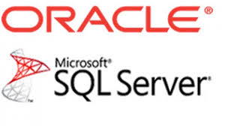

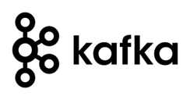


Proposed Architecture
Hortonworks Data Platform
S3Distcp
HDFS
AWS S3
$ amounts
CDC
RDBMS
Real time
search
Lambda
Architecture
Sources
Metadata, Lineage, Security, Operations

Slide 6
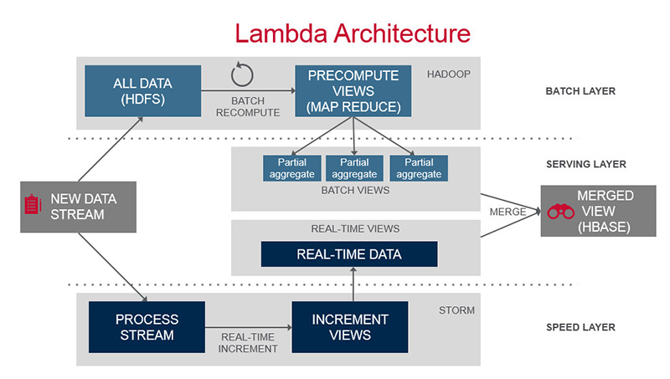
Lambda Architecture

Slide 7
Tools and Technologies
Infrastructure: On premise or Cloud
Security: Ranger, Knox, Kerberos, AD
Metadata & Lineage: Atlas, Falcon
Storage: HDFS, HBase
Data transformations: Spark, Spark Streaming, Spark MLlib, Kafka
BI: Hive(Tez), Solr
Operations: Ambari
Other Tools: CDC (Oracle Golden Gate / IBM CDC / Attunity)

Slide 8
Other Considerations
Data Governance – Quality, Retention, Encryption, Anonymization, Compression
Continuous Integration (CI) and Continuous Delivery (CD)
Operations and Support – Incident Management, Upgrades / Migrations
Data Science Discovery Services
Backup / Restore, Disaster Recovery
Sizing of the cluster
20 Node cluster, 256 GB RAM, 32 Cores, 80 TB HDD

Slide 9
Why Hadoop for this use case?

Slide 10
Why Hadoop for this use case?
Handles exponential Data growth
Accept variety of data sources (like credit scores, bank records, other data sources due to acquisitions, etc.)
Scalable, Reliable, Flexible and Distributed
Rich ecosystem – Diverse tools, Machine learning, Recommendations, Predictive analytics, Real time analysis and Lots of innovation
One-Stop solution
Cost effective

Slide 11
Why Hortonworks for Hadoop?

Slide 12
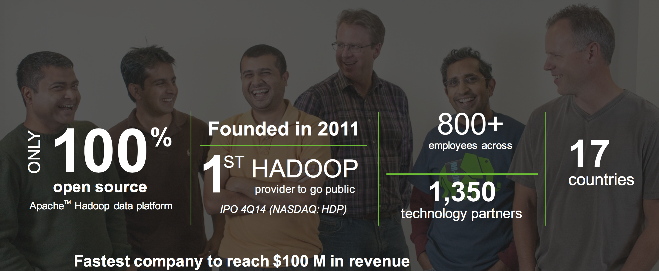
Hortonworks Company Profile

Slide 13
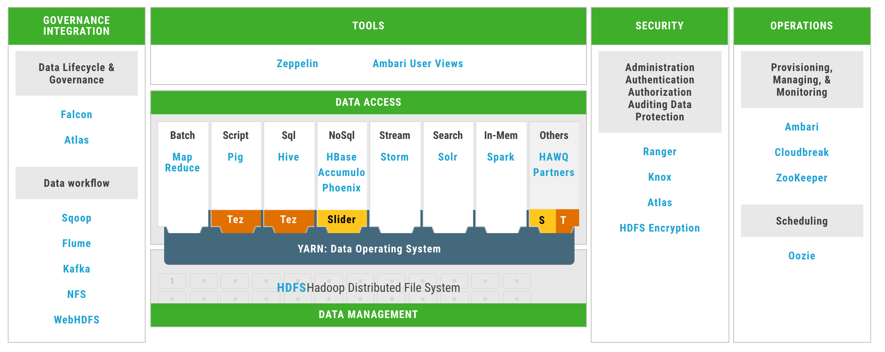
Hortonworks Data Platform

Slide 14
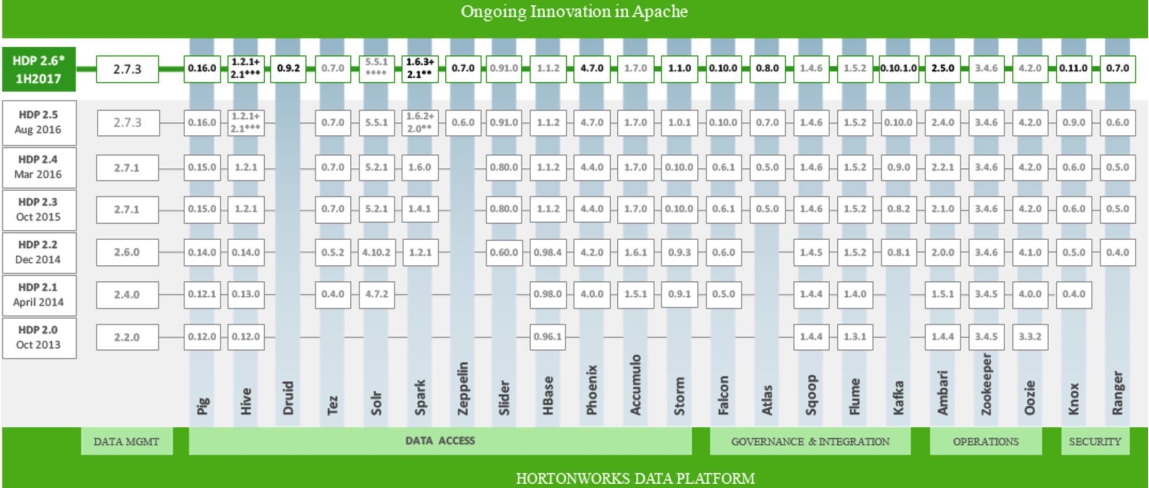
Hortonworks Data Platform

Slide 15
Why Hortonworks for Hadoop?
Only 100% open source
Enterprise Ready
Interoperable
Centralized Architecture: One-stop solution – Ingest, transform, store, access, search, manage, operate, governance, lineage, integration, discover, real time, secure, schedule, cloud, what not!
Lots of innovation, ease of use
Cost effective

Slide 16
Lessons Learnt in Exercise

Slide 17
Lessons Learnt in Exercise
AWS
3 x m4.xlarge (16 GB RAM, 30 GB HDD)
HDFS, YARN, Spark, Hive, Zeppelin, Sqoop, MySQL
AWS – Issues, challenges, etc
snappy-devel package issue
Zeppelin has failed to start
Install required tools on AWS – JDK, MVN, Bzip2, MySQL security, Server time zone
Development to Production (IntelliJ, Github, Sandbox, AWS)
Twitter API access in different time zone issue on Sandbox

Slide 18
Questions?

